Slide 1

How Oregon State University manages Large Scale Drupal
and how to learn from our mistakes
Paul Lieberman
Non-Profit, Government, and Higher Education.
May 21, 2013
Building Bridges, Connecting Communities
Notes:
Welcome to DrupalCon- nice to be in the lead off position.
Introduce myself – a little history
Sher
Thank the association for adding the Non-Profit, Gov, and Higher Ed track

Slide 2

Oregon State University
Corvallis, OR USA
http://oregonstate.edu
http://drupal.oregonstate.edu
OSU Open Source Lab
We host Drupal.org!
http://osuosl.org/
http://osuosl.org/services/hosting/communities
Paul Lieberman
paul.lieberman@oregonstate.edu
Sher Fenn
sherri.fenn@oregonstate.edu
Notes:
OSU - 26,000 students - Very high tech
HP near by
OSL - more than 160 projects, Apache Software Foundation, the Linux Foundation and Drupal.
CWS provides Drupal sites for most of campus - Our servers right next to drupal.org servers.

Slide 3
Today’s Presentation
How OSU was successful in deploying and maintaining a large Drupal installation.
What we are working on currently.
What we have in development for the future.
Notes:
Will go over a lot of technical stuff but not dive too deep into detail
Will show code snippets. Can download the full code from GitHub.

Slide 4
Drupal at OSU
We’ve done a lot of things right that have allowed us to scale to over a thousand installed Drupal sites.
We’ve been victims of our own success – we don’t need that many sites.
Having to support our legacy environment is holding us back.
Notes:
Central Web Services has been hosting Drupal since 2005 with 4.x
Collaboration with Web Communications/Marketing
We provide Training – Sher
Site install – update – database backup
Infrastructure - Helpdesk -Collaboration

Slide 5

Drupal at OSU
Sites Hosted by Central Web Services
Some Colleges host their own Drupal Sites
Notes:
Too many sites
CWS collaborates with colleges on themes and features

Slide 6
Our homegrown
WebManage Application
What It manages:
Site owners and authors
Apache Virtual Hosts and configuration
Drupal distribution directory
File system permissions
MySQL database creation and removal
Drupal site installs
Bulk site updates
Notes:
Written in RoR but uses scripts in python , and PHP.
Showing it’s age.

Slide 7
Standard Drupal Multisite Directory Layout
www.college.edu
|
| - drupal core files
| - sites ---
  | --- all ---
| | - modules
| | - themes
|
| --- site1.college.edu
| | - modules
| | - themes
|
| --- site2.college.edu
| | - modules
| | - themes
Notes:
Disadvantages of multisite
Works best with sub-domain sites
Need symlinks for sub-directory sites
Limits to how far it will scale

Slide 8
OSU Drupal Directory Structure
oregonstate.edu
|
| - drupal core files symlinks
|
| --- site1
| |
| | - drupal core
| | --- sites
| |
| | - all
| | - default
| | - settings.php
| --- site2 | - files
| |
| | - drupal core
| | --- sites
| |
| | - all
| | - default
| | - settings.php
| | - files
| - site x
Drupal core files are symlinks to a common distribution directory.
As is /sites/all including contributed modules, themes, and libraries.
Each site is in it’s own
/sites/default.
Notes:
Advantages
Sites can be placed in any arbitrary place in the web tree
Sites can be nested or combined with non-Drupal sites
Disadvantages
It allows the above
Web tree can become a nightmare

Slide 9
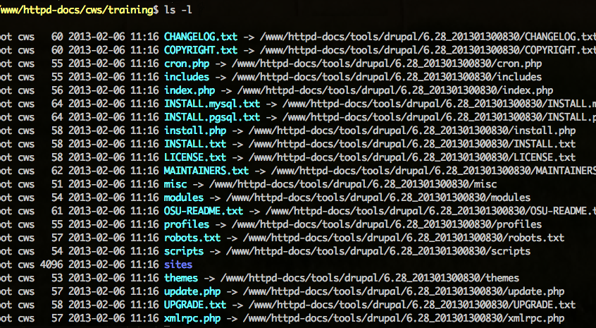
OSU Drupal site directory showing symlinks
Drupal Version_Build Number
Notes:
We use a standard build number to version our distribution.
Normal release cycle every 6-8 weeks depending on security updates.

Slide 10
Python Install Script
Create directory for new site
Symlink Drupal files
Create sites directory
Symlink sites/all
Create sites/default and sites/default/files
Copy in default.settings.php
Set permissions on sites/default/files
Run Drush to install the site
Notes:
WebMange is RoR but it kicks off a Python script to do installs and updates.

Slide 11
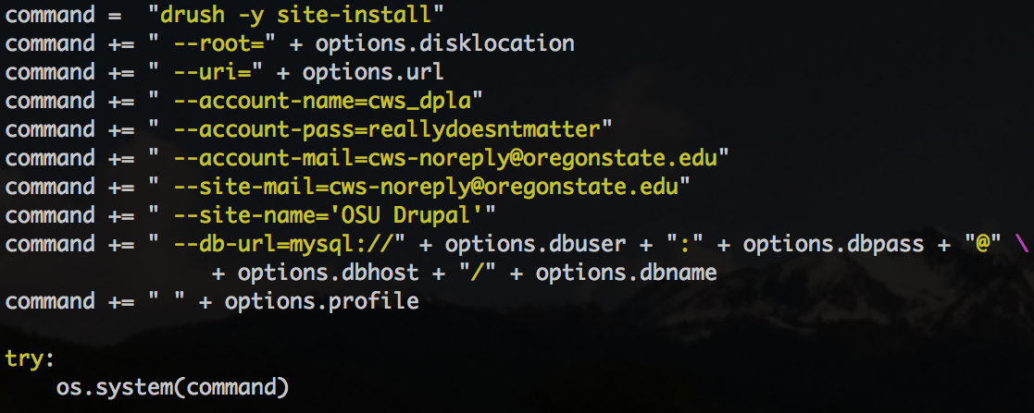
Drush Site Install
Use “drush help site-install” to see all of the options
Notes:
Slide shows use of the drush site-install command
Python script uses Drush to do the install

Slide 12
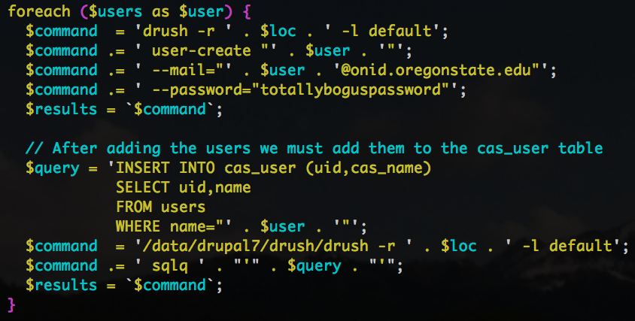
PHP Script to Add Users
Use “drush help user-create” to see all of the options.
Notes:
Slide shows use of the drush user-create and user-add-role commands
Users and roles are defined in WebManage
Drush adds users and assigns roles

Slide 13
Install Profile
Modular design
Setup some default content
Permissions come last
Configuration in features/modules
  Roles
  Cache
  Editor defaults
Notes:
Install profile was a monolithic mess.
Broke it up into functions and eventually split those off into modules.
Permissions rely on modules being installed and initialized.

Slide 14
Using Features for Configuration
Use a feature to define a role
Author role
  Define text filter formats
  Setup WYSIWYG editor
  Define WYSIWYG profiles
  Assign permissions
Notes:
This is an example
See resources

Slide 15
osu_author.info
name = "osu_author"
description = "Configure author role"
core = "7.x"
package = ”OSU Configuration”
;
dependencies[] = "imce"
dependencies[] = "imce_mkdir"
dependencies[] = "imce_wysiwyg"
dependencies[] = "wysiwyg"
;
features[filter][] = "filtered_html"
features[filter][] = "full_html"
features[filter][] = "plain_text"
;
features[user_role][] = "author"
Required Modules
Filter Formats
User Role
Notes:
The modules .info file for the author role

Slide 16
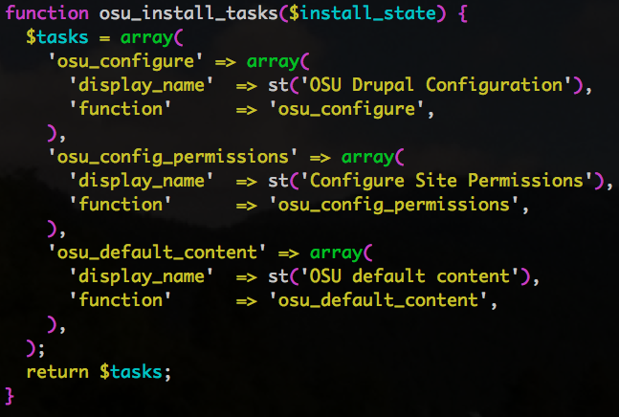
Install Tasks
Notes:
Slide shows hook_install_tasks from the .profile file

Slide 17
Bulk Updates
Update in batches of 20-60 sites at a time
Update script
  Backup database
  Put site in maintenance mode
  Symlink to new distribution directory
  Run database update on site
  Put site back online
  Log progress and send e-mail
Notes:
6 week release cycle for our distribution
Must select sites for update manually in WebManage gui
Python script does the work

Slide 18
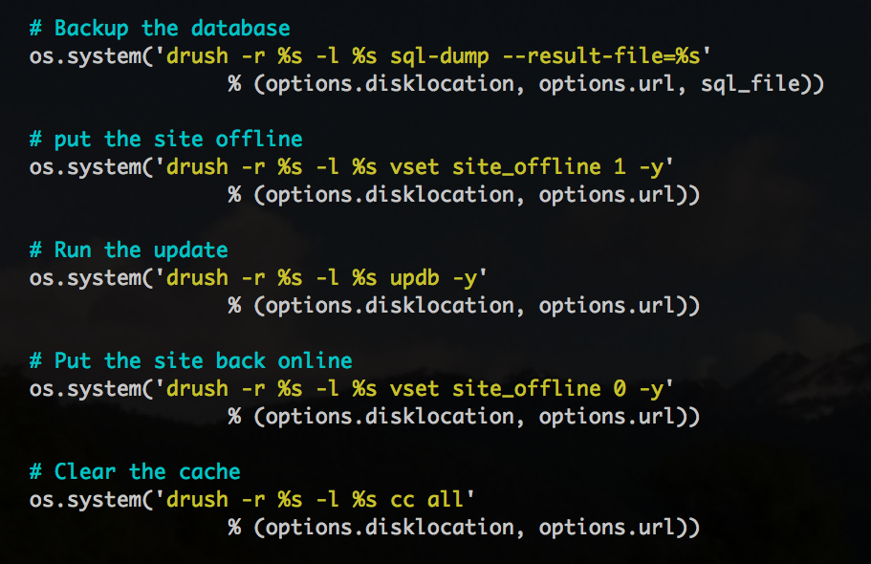
Drush Commands for Update
Notes:
Slide shows drush commands to
Backup the database
Set the site offline
Update the database
Put the site back online
Clear the cache

Slide 19
Running Cron with Cron
Crontab on management server
Runs twice a day for most sites
Python script loops through all sites
Uses Drush to run Cron
See http://drush.ws/docs/cron.html
Notes:
Cron only runs twice a day – some sites need more
Server must have web tree mounted and have rights to it.

Slide 20
Scaling and Caching
Citrix NetScaler provides load balancing and front end cache
Web servers run APC
Search engine requests go to one server
Dedicated memcache servers
Notes:
Netscaler caches most static content (images)
APC is The Alternative PHP Cache for caching and optimizing PHP intermediate code.
Memcache does most of the page caching

Slide 21
Notes:
Netscalers are redundant.
8 Web Servers, mostly under-utilized
MySQL in master/slave configuration

Slide 22
Managing our distribution
Drupal 6 still using SVN
  Entire distribution in repository
Drupal 7 using Drush Make and Git
  Makefile updated for each release
  Custom modules and themes in Git
  Core and Contrib pulled from drupal.org
  Local GitLab for custom projects
Notes:
Still phasing out D6 SVN repo
D6 all in SVN repo (Core, contrib, custom, libraries)
D7 Drush make gets
- Core and contrib come from drupal.org
- Libraries (jquery_ui, tinyMCE, CAS) from wherever
- Custom from our own GitLab server

Slide 23
Drush Make File
Specific version of core
Specific versions of contributed modules
Core and contrib pulled from drupal.org
Local git repo for custom modules and themes
Libraries pulled from respective repos with git, or get (for .zip, .tar.gz files).
Notes:
All modules are versioned
Generate new makefile for each release.
Make file also serves to document what is included in each release.

Slide 24
Some of our weaknesses
Shared infrastructure
Administrative overhead
Learning curve for site maintainers
Manual clone dev to production
Manual distribution maintenance
Updates take a long time
No automated site removal
Notes:
Mixed Drupal and non-Drupal is a mess
Still too many manual steps
D6 sites are bare-bone. Uses have to learn a lot of Drupal

Slide 25
Shared Infrastructure
Web servers must be configured for lowest common denominator.
Cannot be optimized for specific applications.
One misbehaving site or application can affect everything else.
Notes:
A lot of legacy PHP apps require PHP 5.2

Slide 26
In Progress
Site consolidation in Drupal 7
Dedicated infrastructure for Drupal
Phase out WebManage in favor of Aegir
Leverage Aegir backend (Provision)
Notes:
D7 consolidation already begun with small college and IS
Rather put effort into community project (Aegir) than home grown
Automate = reduced workload
Put more power and responsibility into users hands

Slide 27
Site Consolidation
Too many Drupal sites leads to:
  Unnecessary administrative overhead
  Inability to share data between units
  Disjointed navigation within large units
With Drupal 7 we are using Organic Groups to enable us to consolidate large sites.
Notes:
OG is not easy – 2.x helps
Custom helper module to provide
Contextual filters for views
Group names for theme
Manage entity references to link groups to parent units

Slide 28
Too many Drupal Sites
Notes:
Site consolidation a high priority moving into D7

Slide 29
Using Organic Groups
Notes:
Objectives
- Provide granular authoring permissions
- Give the departments some distinctiveness
- Share resources, like faculty profiles, between departments.
- Provide consistent college wide navigation
Applies to administrative units as well

Slide 30
Dedicated Infrastructure
Each service gets dedicated resources.
Servers can be optimized specifically for each service.
Services are isolated and protected from one another.
Notes:
We support
- Drupal
- Wordpress
- RoR Apps
- Legacy PHP apps

Slide 31
Future Environment with Aegir
Notes:
Leveraging VMWare and our shared infrastructure group
Working well in dev – Production this summer

Slide 32
Using Fabric to control Aegir
Python scripts use SSH for remote commands
Drush uses Provision (Aegir backend) to build Platforms and Sites
Checkout work done by Mig5
  See http://mig5.net/node/342
Notes:
Mig5’s Zero Touch Deployment is a must read.
Explain Aegir
Frontend Hostmaster
Backend Provision

Slide 33
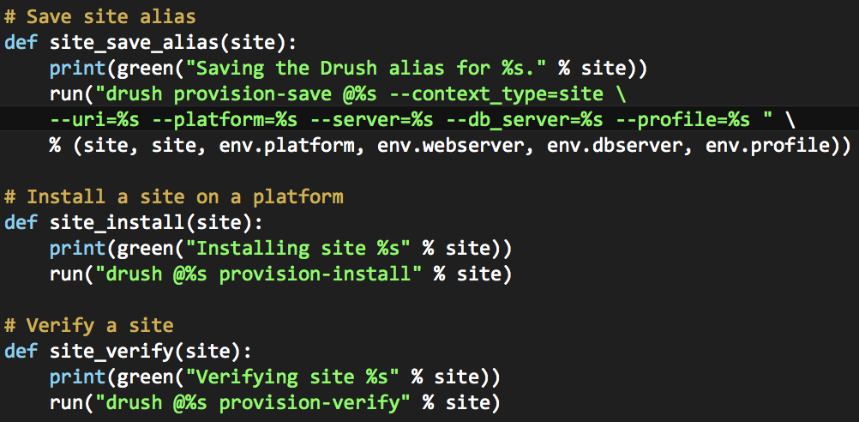
Fabric – Drush - Provision
Use “drush --filter=provision” to see all of the provision commands.
Notes:
Modified from Mig5’s work
Leverage Aegir backend – Provision module
Use drush help to see how all of these commands work

Slide 34
Puppet to Install Aegir Servers
Server Base – OS and common utilities
Aegir Base – Aegir user, Drush, and Provision
Aegir WebServer – Apache for Aegir
Aegir DBServer – MySQL server for Aegir
Aegir Hostmaster – Aegir frontend
Also Memcache and Varnish
Notes:
Our puppet modules available on Github
Using this now for all new servers

Slide 35
Our Development Environment
Most development in main web tree
Central git server using GitLab
Experimenting with CI using Jenkins
Notes:
We do in house development for themes and modules.
Looking to move more apps into Drupal.
Leveraging Drupal for mobile development using Services and Views.

Slide 36
Development Environment
Notes:
Jenkins detects developer commits and kicks in a build in the testing environment.
Once again see work done by Mig5

Slide 37
Continuous Integration
drush @site-alias update -n --pipe
Notes:
Detect updates
Create Makefile
Build Platform
Migrate Sites

Slide 38
Looking Ahead
Self service site provisioning
Auto expire/delete for training and dev sites
Drupal site Control Panel
Drupal systems dashboard
Notes:
This stuff is in early development

Slide 39
Self Service Site Provisioning
Pilot using training sites
Drupal form to request a site
Drush Provision creates the site
Site monitored for inactivity
Warning sent to site owner for inactive sites
If no activity after a set period sites are archived and deleted.
Notes:
Further out – not yet in production

Slide 40
Auto site expire/delete
drush @site provision-enable
drush @site provision-disable
drush @site provision-backup
drush @site provision-delete
drush @site provision-restore
drush @site provision-backup_del
Notes:
Like Drupal Gardens

Slide 41
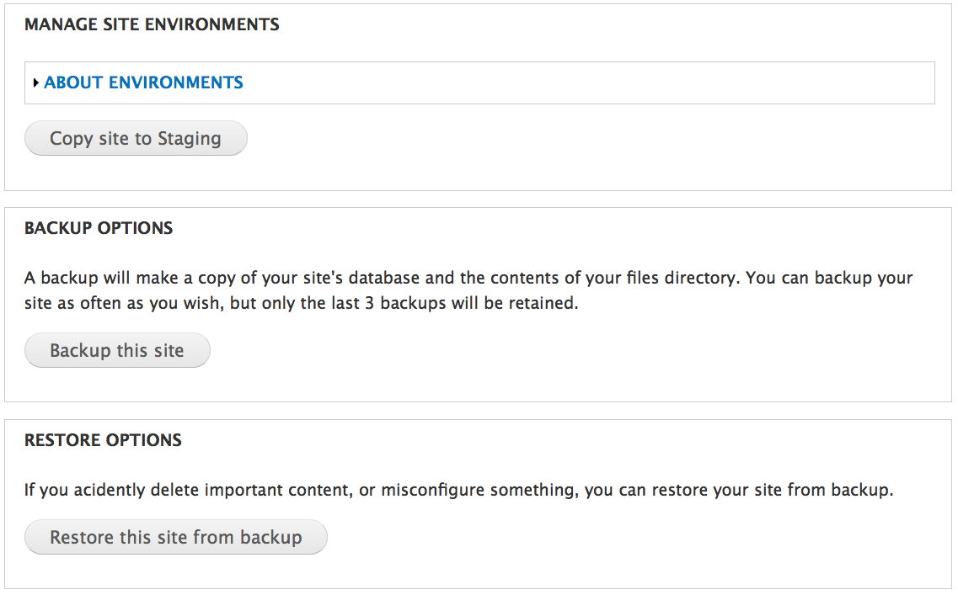
OSU Drupal Control Panel
Notes:
Empower users to better manage their own sites.

Slide 42
Control Panel Backend
Copy site to dev, staging, or production
  Drush provision-clone
Backup site
  Drush provision-backup
Restore site
  Drush provision-restore
Notes:
Once again the provision module provides all the necessary functionality.

Slide 43
Drupal Site Provisioning
Self-service provisioning for training sites
Site requests for development sites
User management
  Site managers
  Site architects
  Site authors
Notes:
Still need to determine how best to manage users.

Slide 44
Drupal Systems Dashboard
Resource Management
  Monitor resource usage
  Adjust resource allocation
Manage distributions
Site backup and restore
Initiate automated upgrades

Slide 45
What really makes us successful?
All the great people working on Drupal at OSU.
The Drupal community.
Notes:
OSU people standup.

Slide 46
Resources
Mig5’s Zero Touch Drupal Deployment
  http://mig5.net/node/342
Code Driven Development
  http://nuvole.org/blog/2011/mar/25/code-driven-development-cheatsheet
OSU code on Github
  https://github.com/oregonstateuniv/puppet-aegir
  https://github.com/oregonstateuniv/fabric-aegir
  https://github.com/oregonstateuniv/drupal-install-profile

Slide 47
Questions?

Slide 48
What did you think?
Evaluate this session at:
portland2013.drupal.org/schedule.
Thank you!
Building Bridges, Connecting Communities

