Slide 1


InnoDB Replacement with
DeepDB for MySQL
DrupalCon 2013

Slide 2


Introductions
What if you could make your Drupal site run 10x faster with no tuning knowledge?
Jason Ford
CTO, BlackMesh
Jason Jeffords
CTO, CloudTree

Slide 3


Slide 4

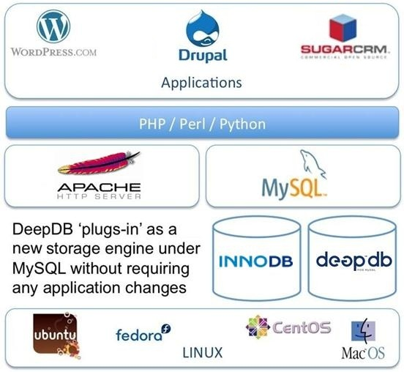
  100% InnoDB compliant, easy to install storage engine plug-in for MySQL 5.5
  12x or more increase in server capacity on average
  100x or more increase in industry-standard performance benchmarks
  40% or more reduction in database on-disk footprint (before compression)
  No application code changes
  Full MySQL API implementation
  Instantaneous startup & shutdown
  Integrated audit & roll-back capabilities
  All previous database states maintained/archived

Slide 5
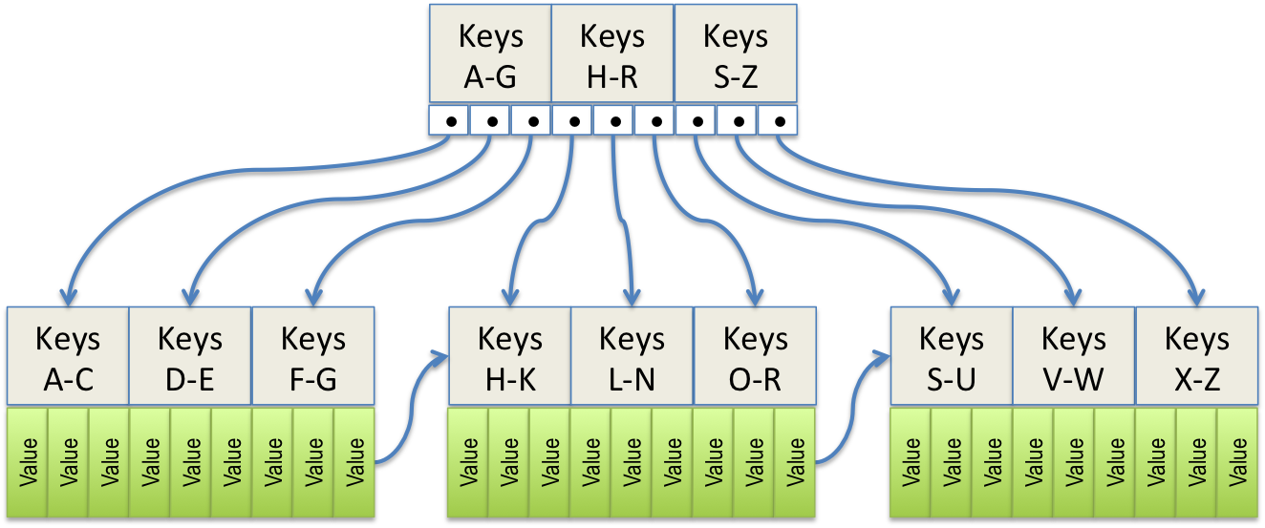
Traditional Database Architecture
Traditional database architectures use the same data structures in-memory and on-disk, most often B+ Tree’s or LSM Trees
Legacy design circa 1970!
Conventional Approach for Building a Database Table
In-Memory
On-Disk
B+ Tree
B+ Tree
Memory Mapped File I/O

Slide 6
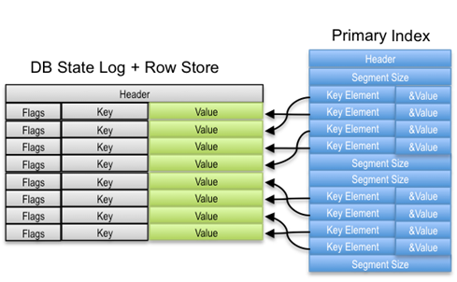
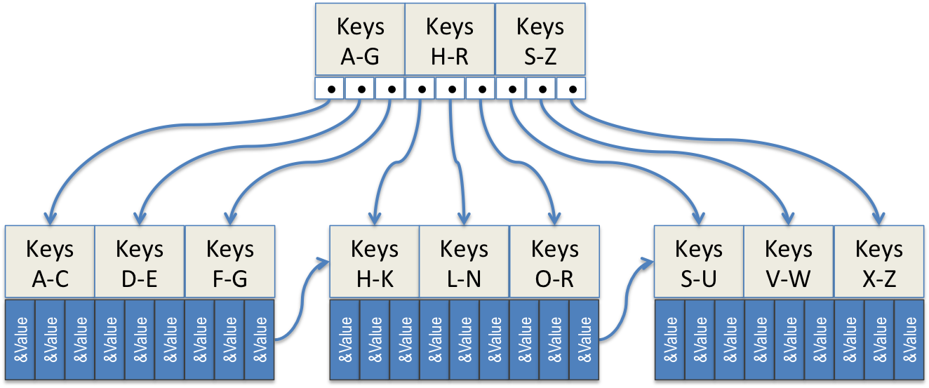
A New Approach to Database Architecture
DeepDB has taken a new approach, by using different structures in-memory than on-disk and by eliminating the memory mapped file I/O
Real-time Relative Cache-Ahead System (RRCA)
In-Memory
On-Disk
Enhanced B+ Tree
Cache-Ahead Summary Indexing
(CASI) Tree
Streaming File I/O

Slide 7

Advantages for Write Operations
Standard On-Disk Behavior
Big O complexity: O(log(n)) – number of disk operations (e.g.: seeks) increases as the # of rows expands
Examples:
  500,000 row database requires 4 seeks*
  10,000,000 row database requires 5 seeks*
Virtually Seek-less Behavior
Big O complexity: O(1) – constant time operation independent of database row count
No page-based operations – only the changes are written to disk
  Averages much less than 1 seek per write
All adds, deletes and updates are appended to the end of the database, thus no seek required!
* https://dev.mysql.com/doc/refman/5.5/en/ estimating-performance.html

Slide 8
Advantages for Read Operations
Standard On-Disk Behavior
Big O complexity: O(log(n)) – number of disk operations (e.g.: seeks) increases as the # of rows expands
Examples:
  500,000 row database requires 4 seeks*
  10,000,000 row database requires 5 seeks*
CASI Tree Behavior
Big O complexity: O(log(n)) – number of disk operations (e.g.: seeks) optimized based on database size
Examples:
  500,000 row database requires 1 seek
  10,000,000 row database requires 1 seek
CASI Tree designed to eliminate seeks; forces all reads to be optimized for sequential access
* https://dev.mysql.com/doc/refman/5.5/en/ estimating-performance.html

Slide 9
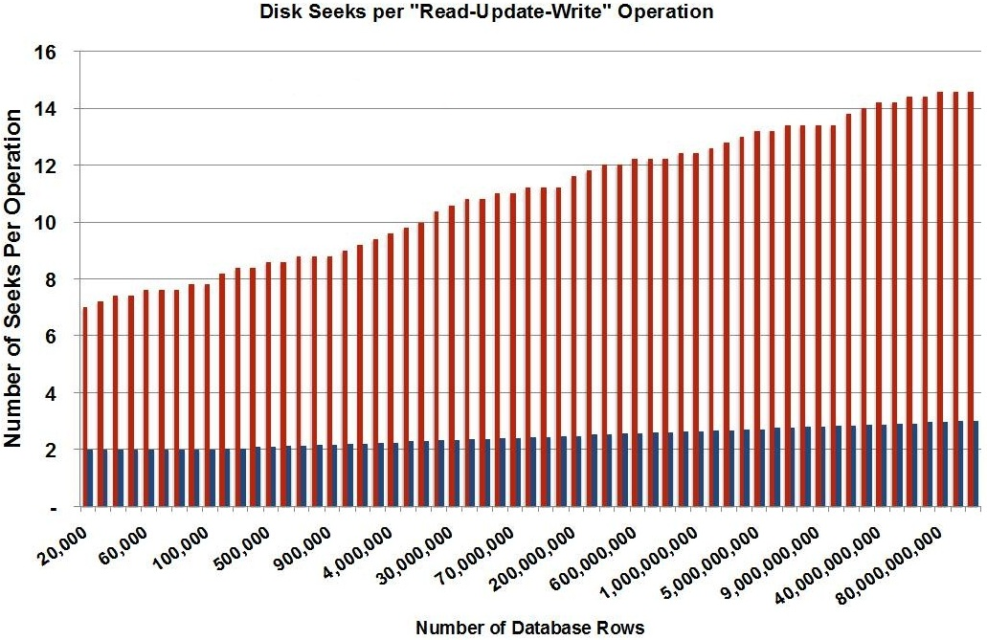
The Results: Hyper-Efficient Disk I/O
78% reduction in disk seeks compared to InnoDB
For 1M rows, worst case SysBench latency is 39ms (DeepDB) vs. 24,561ms (InnoDB)
Provides SSD-like performance on HDD’s
Extends wear life of SSD’s by an order of magnitude

Slide 10
The Results: Industry-Standard Benchmarks
 | MySQL with DeepDB | MySQL with InnoDB | Improvement with DeepDB
iiBench Maximum Transactions per Second Single index, 25 clients, 4GB cache, 32 cores, HDD | 1.72 million/sec | 32,000/sec | 53x
SysBench Transaction Rate 1M rows, 4GB cache, 32 cores, HDD | 15,083/sec | 1,381/sec | 10.9x
DBT-2 Transaction Rate 50 clients, 20 warehouses, scale=1,SSD | 235,577/min | 73,131/min | 3.2x
DBT-2 Transaction Rate 50 clients, 20 warehouses, scale=1,HDD | 205,184/min | 15,086/min | 13.6x
iiBench - 100M rows loaded, 7 indexes w/composite keys, 24 clients, 4GB cache, 24 cores, SSD
Initial Load | 10 minutes | 240 minutes | 24x
First Query from Cold Start | 29 seconds | 90 seconds | 3.1x
Second Query from Cold Start | 0.48 second | 35 seconds | 72x
Disk Storage Footprint | 12 GB | 20 GB | 40% smaller
iiBench - 250M rows loaded, 7 indexes w/composite keys, 24 clients, 4GB cache, 24 cores, SSD
Initial Load | 15 minutes | 24 hours | 96x
First Query from Cold Start | 50 seconds | 330 seconds | 6.6x
Second Query from Cold Start | 1 second | 240 seconds | 240x
Disk Storage Footprint | 29 GB | 50 GB | 42% smaller
Avg. Disk Seeks per Operation (Read-Update-Write) | 2.43 seeks | 10.97 seeks | 78% fewer
Notes:
Put competitors on here, like TokuDB. DBT-2 isn’t useful. Here’s two tests, and make it simpler. What is the workload to focus on? Which apps have the largest disk i/o problems? Partitioning? Archiving (simple r-sync)? Sharding?

Slide 11

DeepDB: Installs Quickly Replacing InnoDB
Migrate in hours
Table Alter
To change storage engine to DeepDB for each desired table:
  ALTER TABLE tableName ENGINE = DeepDB
Reference:
  http://dev.mysql.com/doc/refman/5.5/ en/alter-table.html
Dump/Load
mysqldump db_name > backup-file.sql
Edit backup-file.sql to change storage engine to DeepDB for each desired table
mysql db_name < backup-file.sql
Reference:
  http://dev.mysql.com/doc/refman/5.5/ en/mysqldump.html & mysql.html

Slide 12
DeepDB: Value Proposition Summary
Unified Solution for Real-time Analytics and Transaction Processing
  Same database for both transactions and analytics
  Single database to buy, operate and maintain
Reduces Computing Hardware Requirements
  12x or more increase in server capacity on average
  100x or more increase in industry-standard performance benchmarks
  40% or more reduction in database on-disk footprint (before compression)
Provides Best-in-Class Cost per Transaction Profile
  75% lower cost than next best-in-class offering
  Enables SSD performance on traditional HDD
Provides Vastly Improved Time-to-Results
  Increased transaction processing rate and reduced latencies
  High performance, low latency, advanced queries
  Five nines availability with continuous indexing and on-line defragmentation
Flexible ‘Plug-in’ Architecture Easily Fits Existing Database Environments
  Fully featured compliant interfaces require no application changes
  Installs quickly & easily using standard dump/load or table alter providing results within hours
  Provide an environment for rapid development with support for familiar tools/tool chains

Slide 13
Thank You!
DrupalCon 2013

