Slide 1


Global Health eLearning
Drupal Based Learning System for Global Health Providers in Developing Countries
DrupalCon 2013
Notes:
1

Slide 2
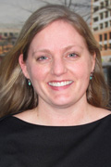
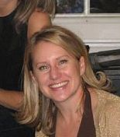
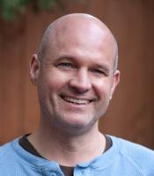
Your Presenters…..
Sara
Terra
Bill
Notes:
2

Slide 3
And you…..
Who are you?
What are you expecting from this presentation?
What are your burning questions?
Notes:
3

Slide 4
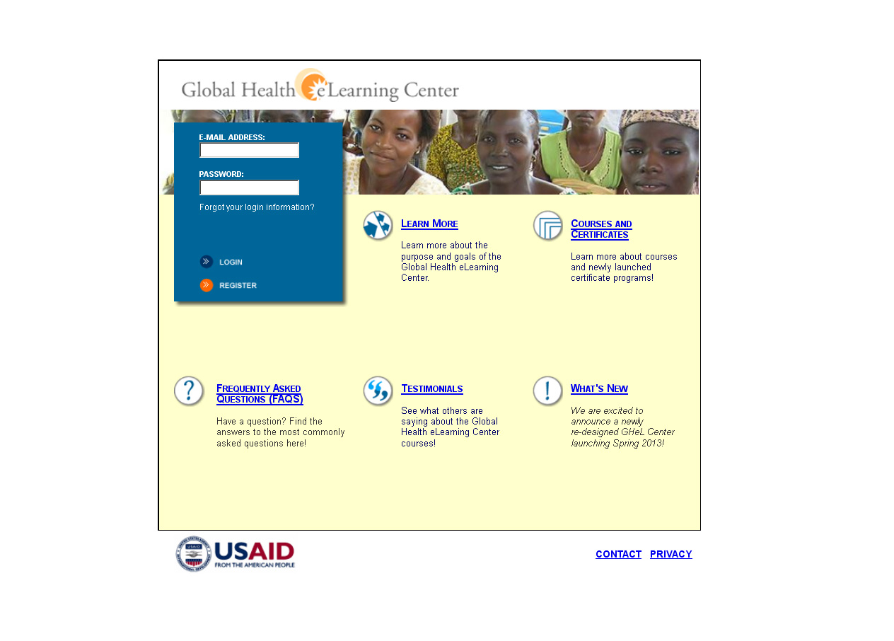
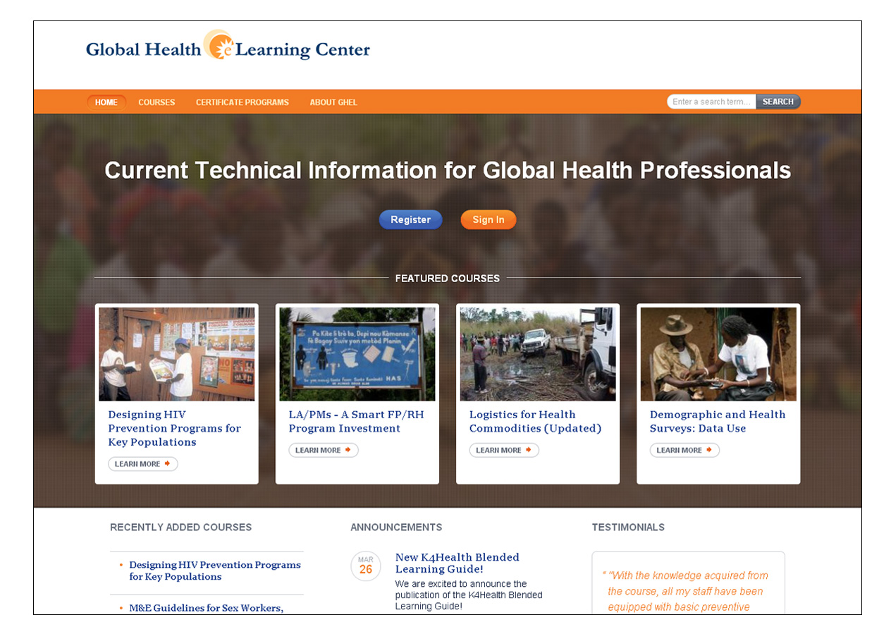
Global Health eLearning Center
Notes:
Started in 2005
Partnership b/w USAID and JHU and MSH
Initial goal to provide worldwide health staff with access to state of the art technical global health information on global health topics and health programming in USAID health projects
Demand for information is staggering and the audience grew well beyond initial estimates

Slide 5
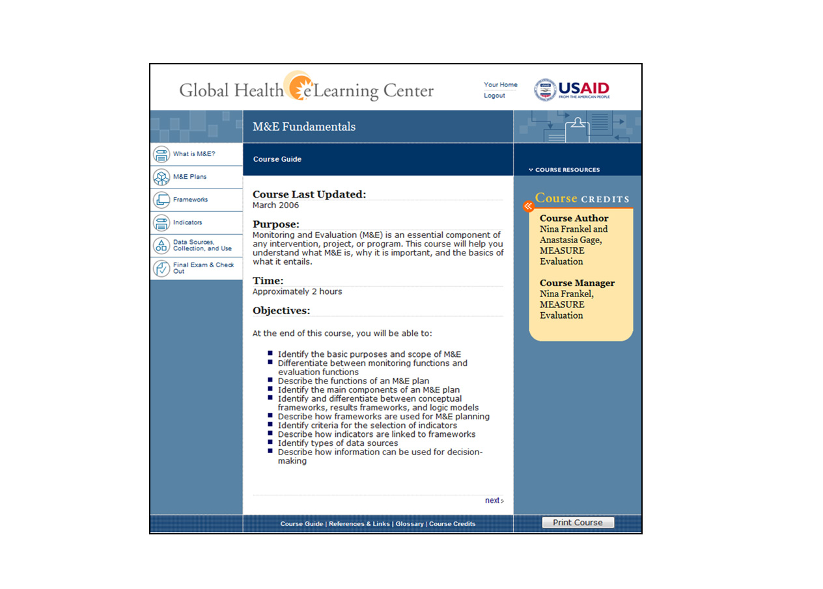
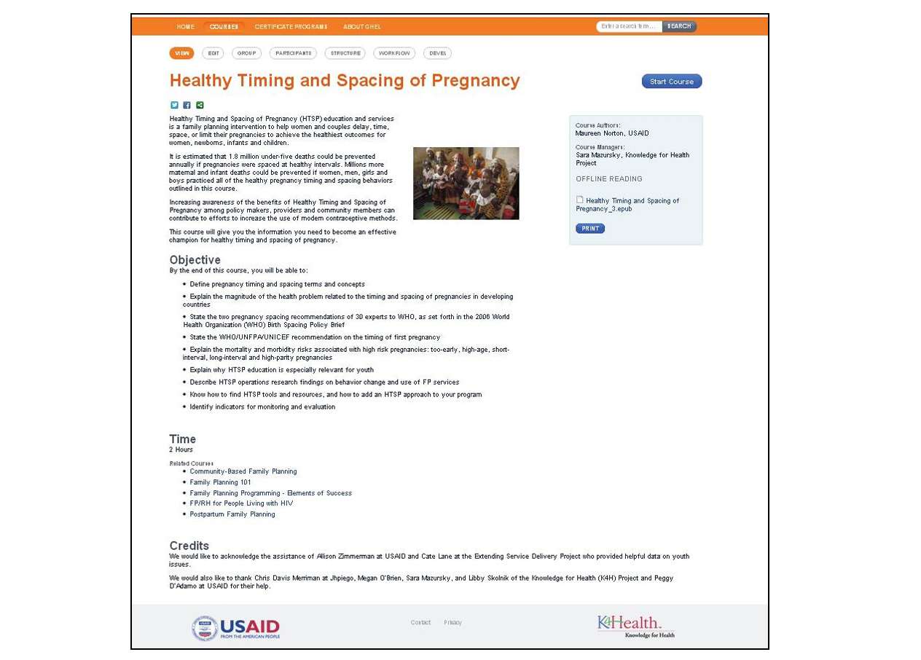
Global Health eLearning Center

Slide 6
Primary and Secondary Audience
Notes:
Health officers primary audience – 20% of users
80% of users non-USAID
Most users are in developing countries, low bandwidth, often shared computers
Huge demand for courses
Minimal promotion efforts

Slide 7
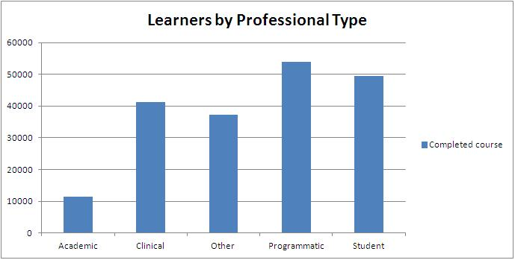
Learner Profile
96,847 registered learners
195,636 certificates earned
245 countries represented
Notes:
7
Closing in on 100K registered learners, many learners average over 3 certificates each, nearly every country represented.
Most are programmatic, students and clinical.
Fact on fragile states (sara to add)

Slide 8
Benefits of Courses
Increased job performance (self-reported)
Program strategy, planning, and implementation
Technical meetings and conferences
Developing materials for health workers
Advocacy efforts
Job interviews

Slide 9
Old Site Limitations
Organizational
Technical
Notes:
Cold Fusion legacy site
Use of courses increasing but flexibility not changing with need
Immense amount of content needed to transfer to new site and maintain functionality

Slide 10
New Site Technical Challenges
Instructional design needs drove decisions and user experience
Flexibility in user control
Notes:
The goal of the project was to make GHeL:
Modernized with an updated and cleaner look as we add new content
A collaborative space and include features, such as user ranking of courses and a space for learners and instructors to interact
A portal to more distance learning resources and courses
SCORM compliant, or content sharing friendly, and allow for the integration of courses onto other platforms and vice-versa
Based on open source technology

Slide 11
New Site Features
Site wide glossary
Feedback capability
Learner controlled action plan
Multi-browser/devise compatibility
Offline reading capability

Slide 12
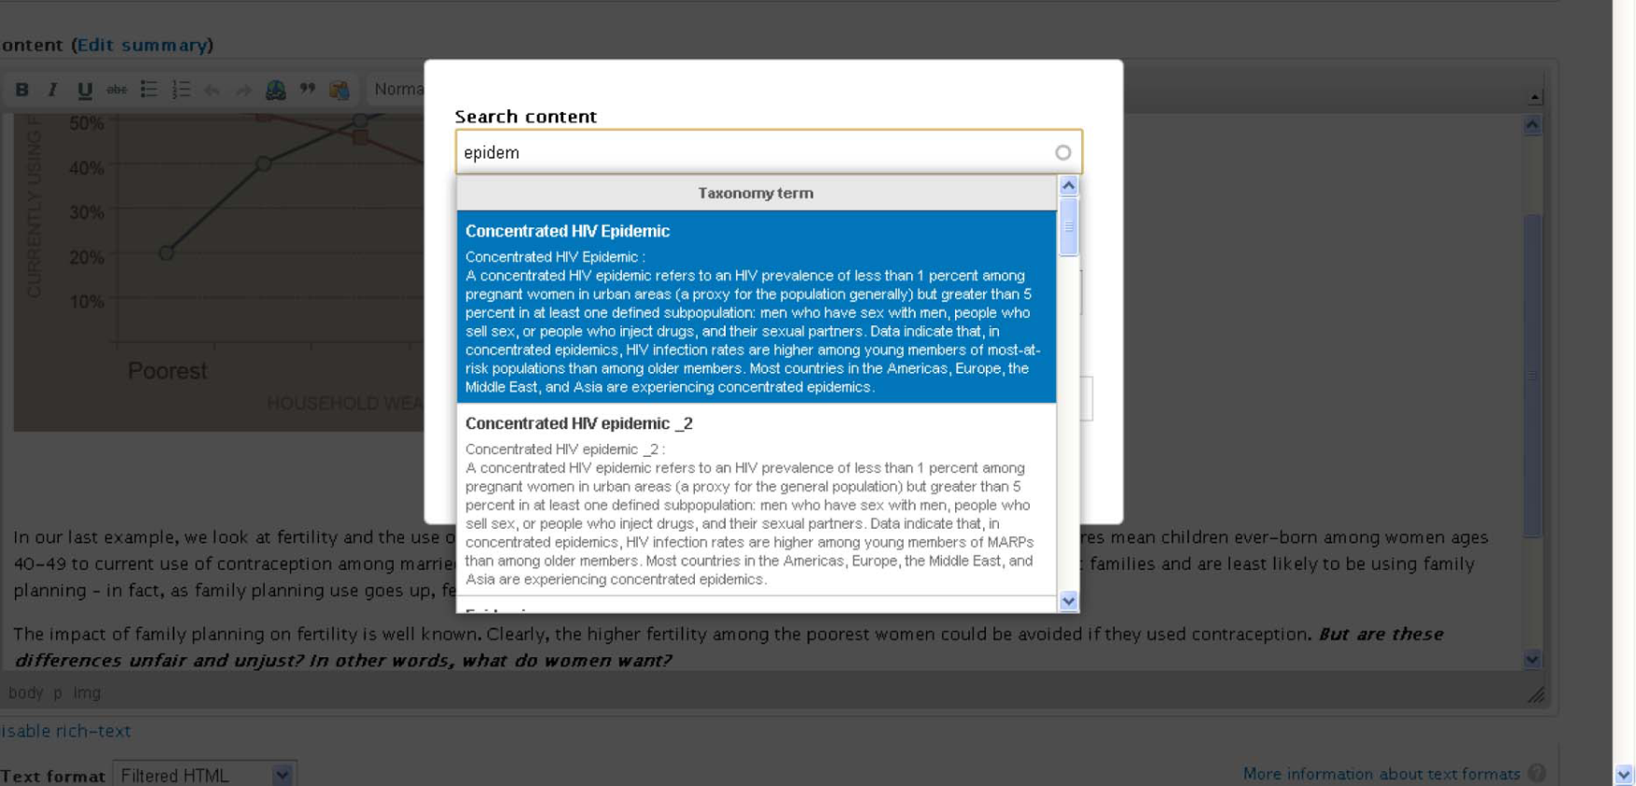
New Site Features
Site wide glossary
Notes:
12
Site wide glossary enables course authors to use vetted terms within their courses.
Helps maintain consistency in messaging across the course offerings.

Slide 13
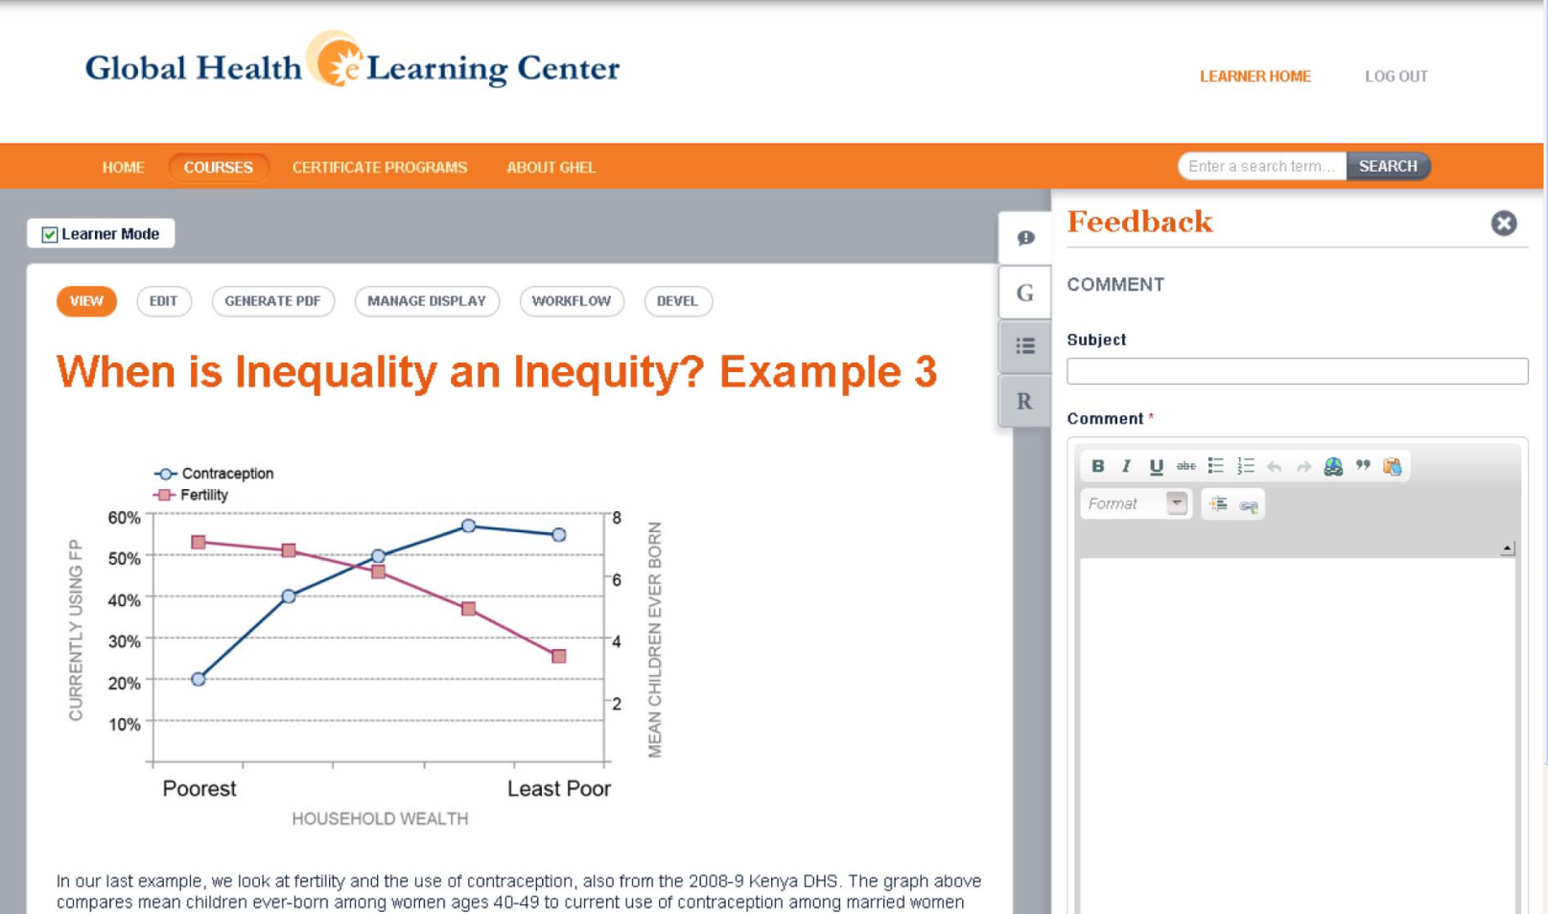
New Site Features
Feedback capability
Notes:
13
Extensive and cumbersome technical review of courses is made easier by a in-line feedback feature for courses in development.
The days of faxing comments is coming to a close!

Slide 14
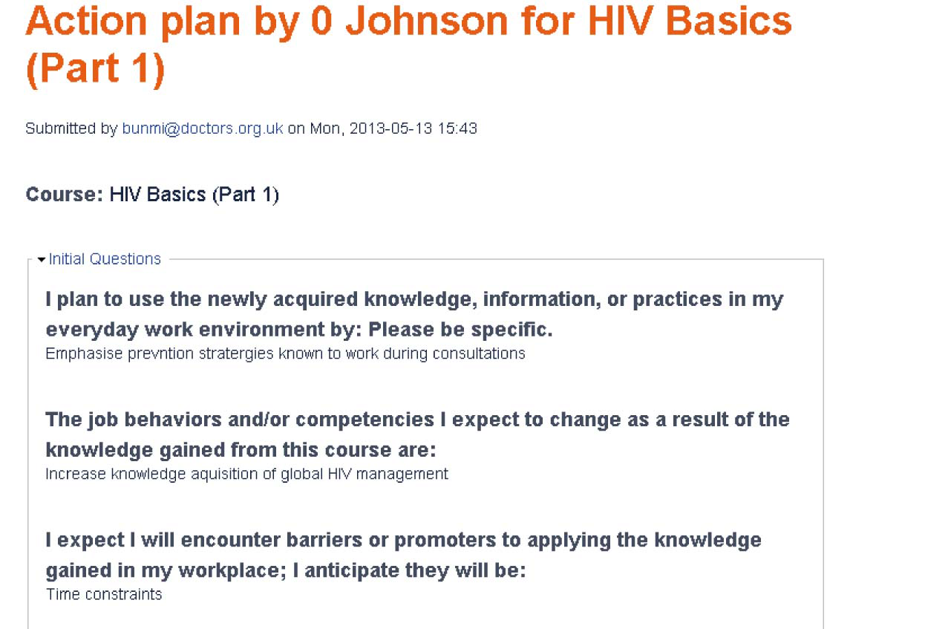
New Site Features
Learner controlled action plan
Notes:
14
Action plan is a mandatory element in the workflow to getting a certificate of completion. Action plan are also now available to learners on the site.
After so many years of “smile sheet data” we have moved more towards application and use of knowledge. Ideally this would be an element of conversation amongst learners and used as part of a blended learning approach.

Slide 15
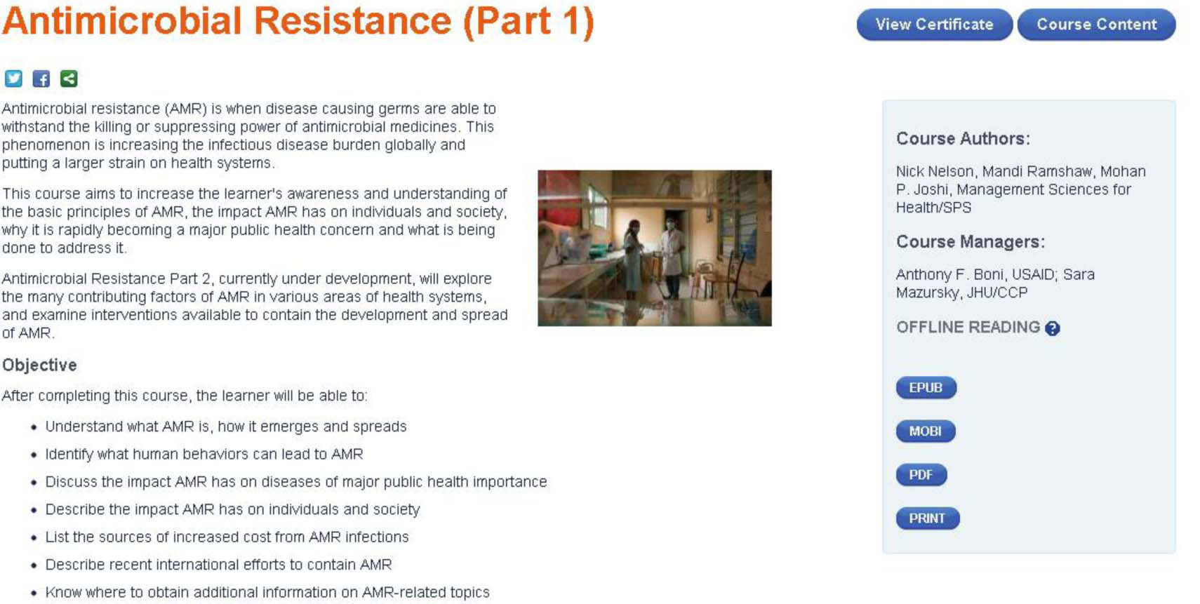
New Site Features
Offline reading capability
Notes:
15
We’ve had large demand for course content in offline formats. This has been expensive and required a substantial LOE to address in the past.
The new site offers 4 offline reading features that are automatically created when the course is built.

Slide 16
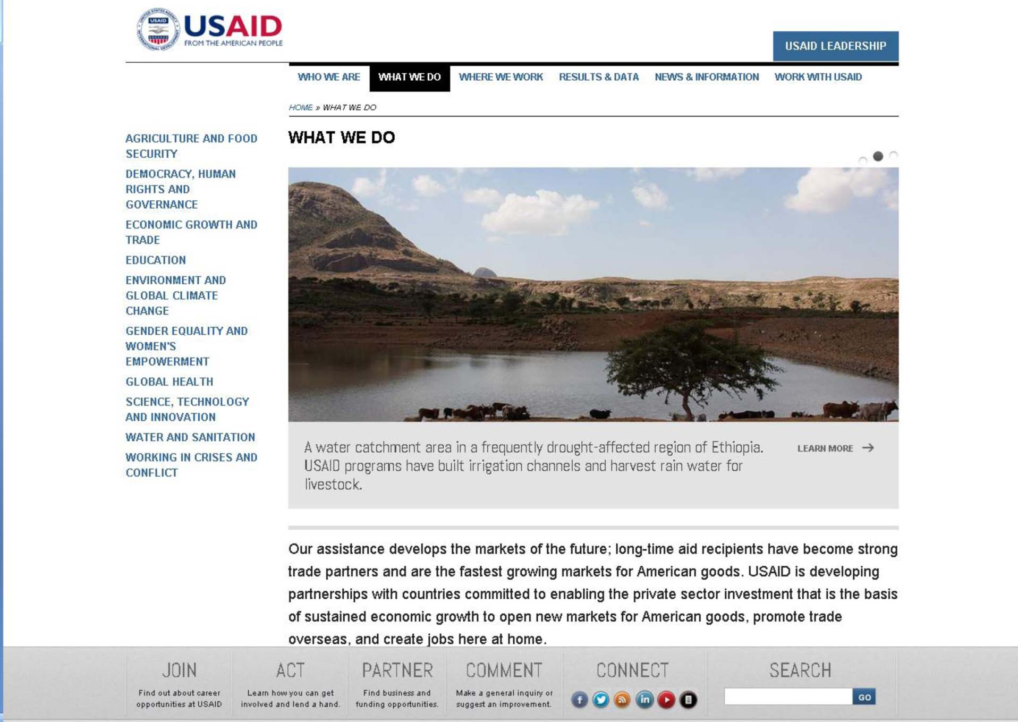
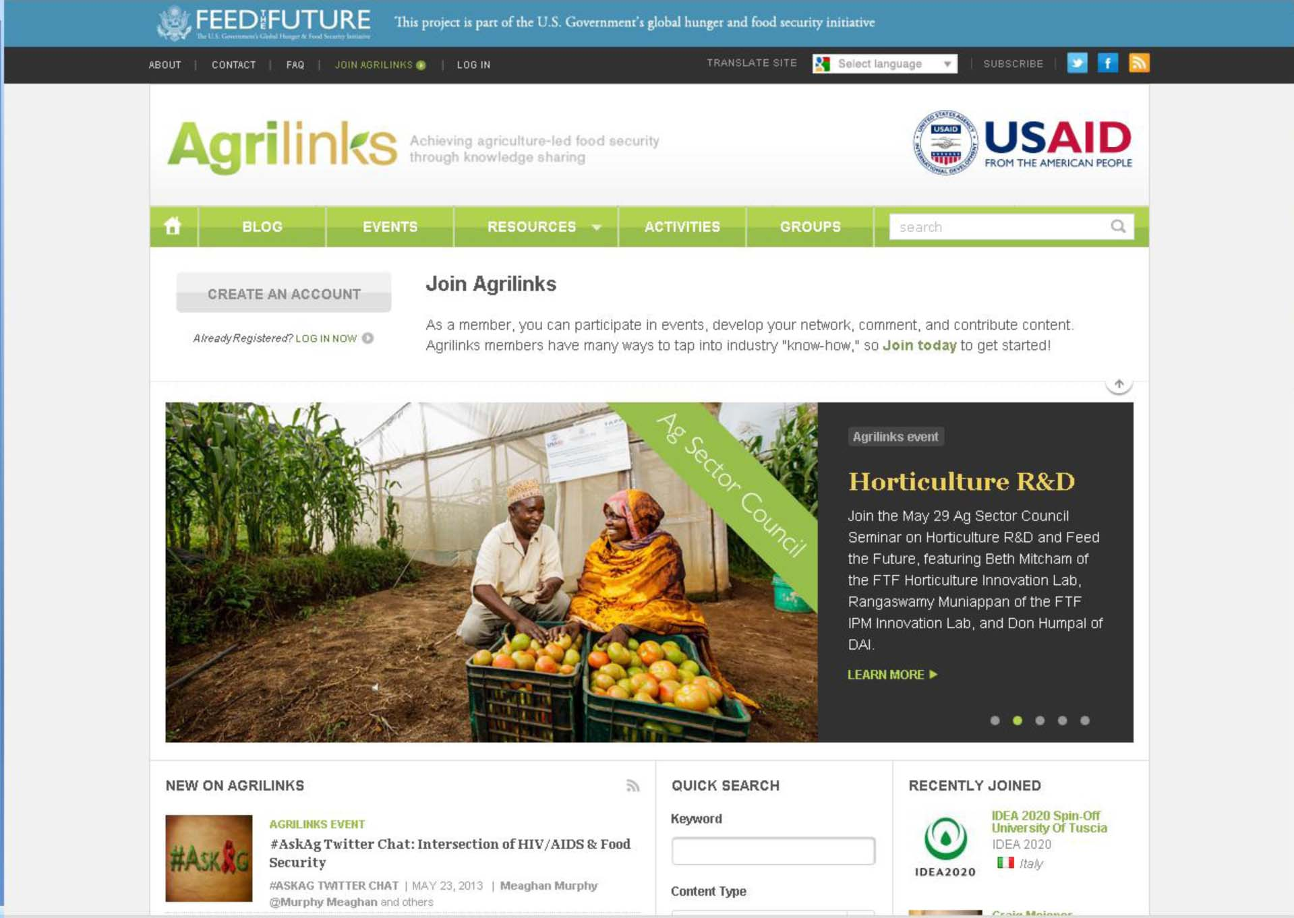
Why Drupal was the Right Choice
USAID Drupal use
Notes:
16
USAID is increasingly using open source platforms and has used Drupal for several high profile sites in the last few years. The main USAID website was recently redesigned and used Drupal.
The Agriculture and Food Security folks Feed the Future initiative, also has a collaborative site that is based in Drupal.

Slide 17
Why Drupal was the Right Choice
Long term flexibility
Flexible Theming Layer
Quiz Functionality
Notes:
17
For GHeL, we wanted to be consistent with donor trends, but also nearly the entire K4Health portfolio is build in Drupal so we have the staff to support it, and we wanted to make future integration as easy as possible.

Slide 18
Implementation Details I
Drupal or Moodle?
Course Structure
Feedback and Course Revision Process
Notes:
18

Slide 19
Implementation Details II
Offline Reading
Future-Proofing the Architecture
Making Drupal Not Look Like Drupal
Notes:
19

Slide 20
The way forward
Addition of community features to encourage peer-peer learning
Contribution back to Drupal
Notes:
20
We will be rolling out new features that will help foster a learning community and support our increasing blended learning work with partners in developing countries.
We are working on contribution details....

Slide 21
Questions?
Sara Mazursky: smazursk@jhuccp.org
Bill Fitzgerald: bill@funnymonkey.com
Terra Fretwell: tfretwell@usaid.gov
Notes:
21

