Slide 1
FEMA’s Public Affairs Digital Strategy

Slide 2
FEMA’s Mission Statement
“FEMA’s mission is to support our citizens and first responders to ensure that as a nation we work together to build, sustain, and improve our capability to prepare for, protect against, respond to, recover from, and mitigate all hazards.”

Slide 3
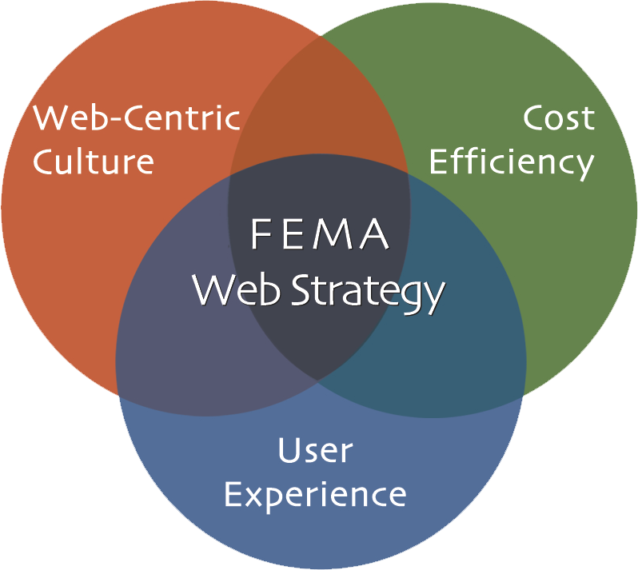
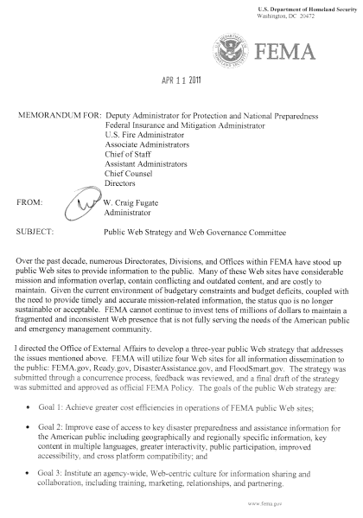
April 11, 2011

Slide 4
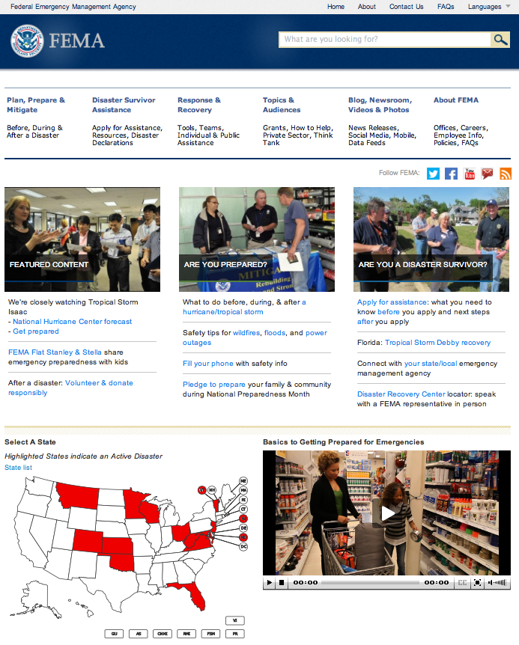
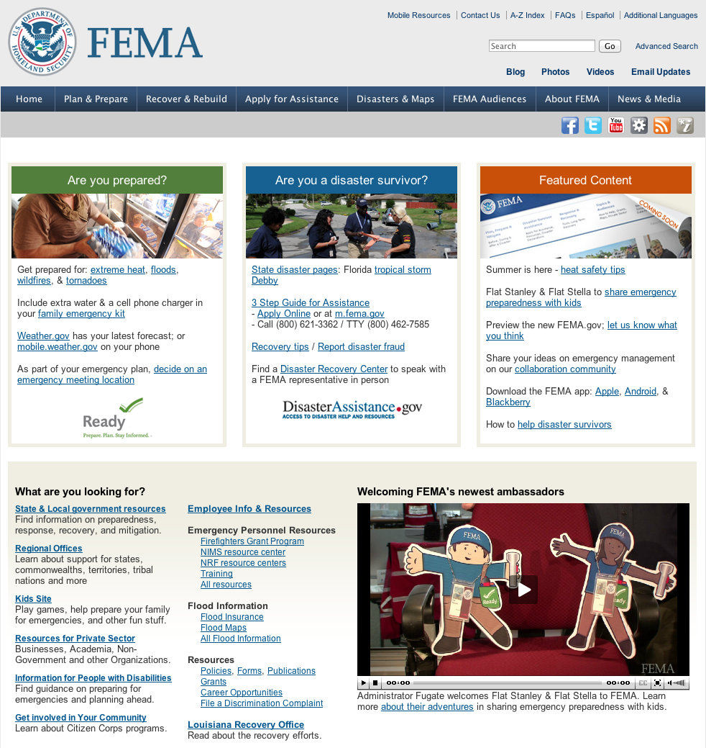
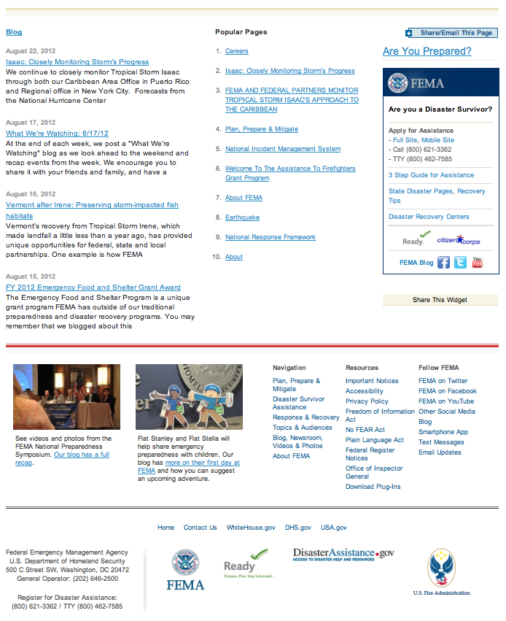
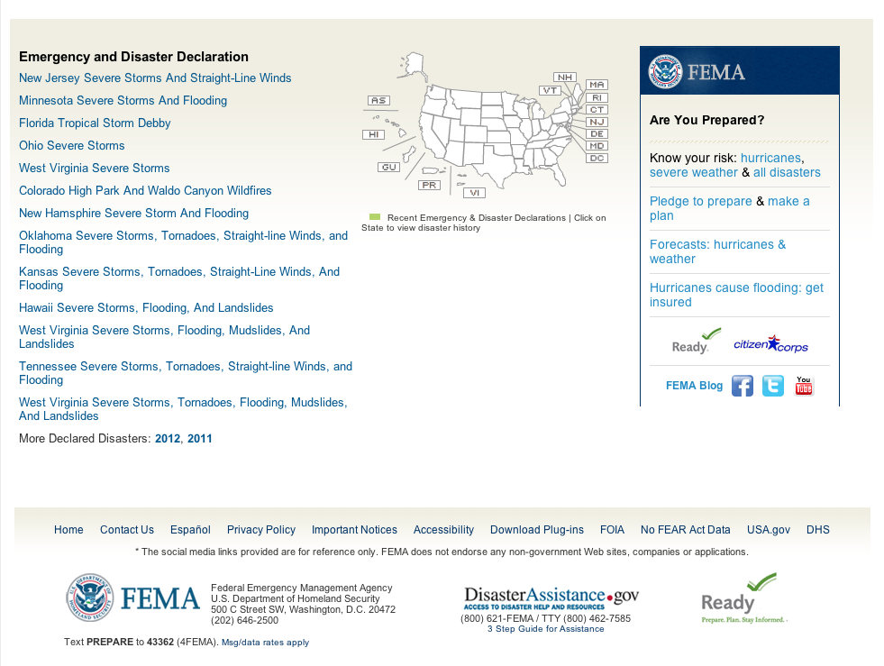
Completely Redefined FEMA.gov

Slide 5
Institutional Transformation
Change from Centralized to a Distributed Publishing Approach
Change from Organizational Based to Topic based Information Architecture
Establishing
a web centric
culture

Slide 6
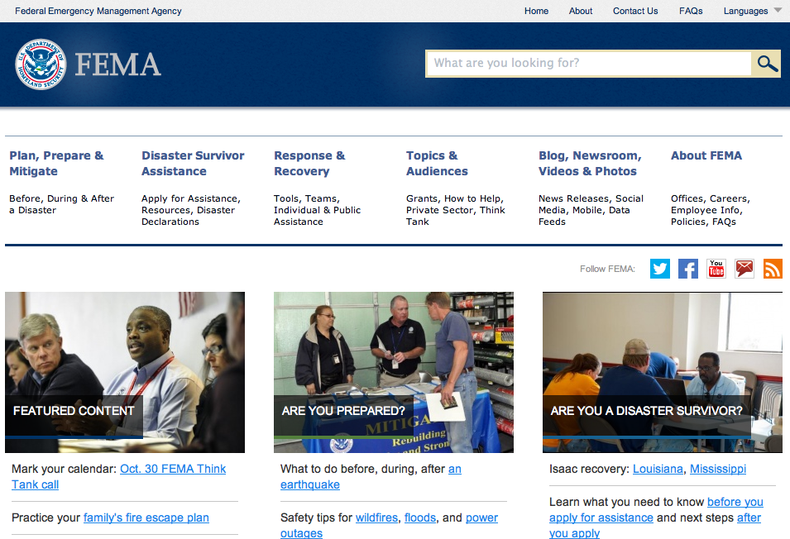
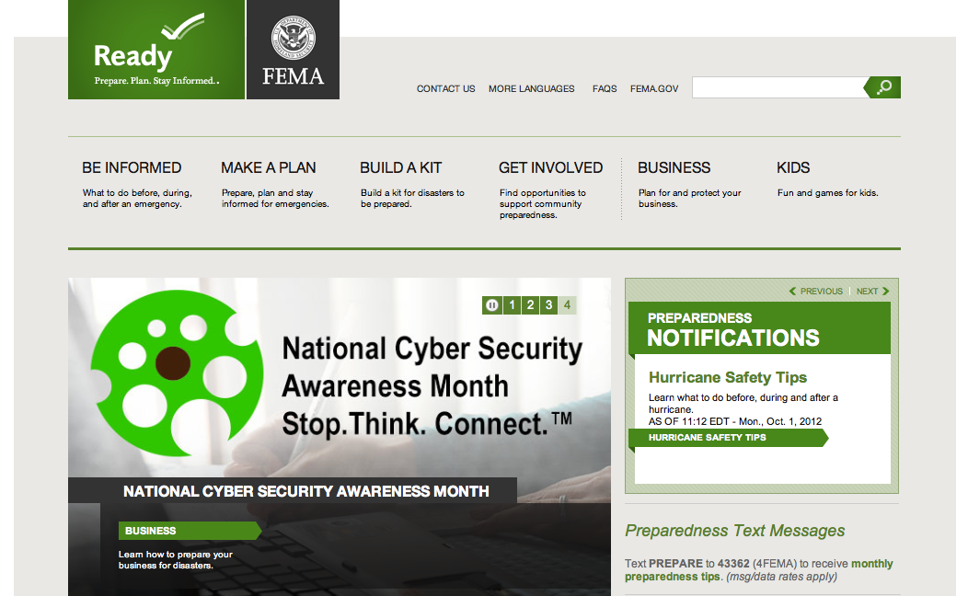
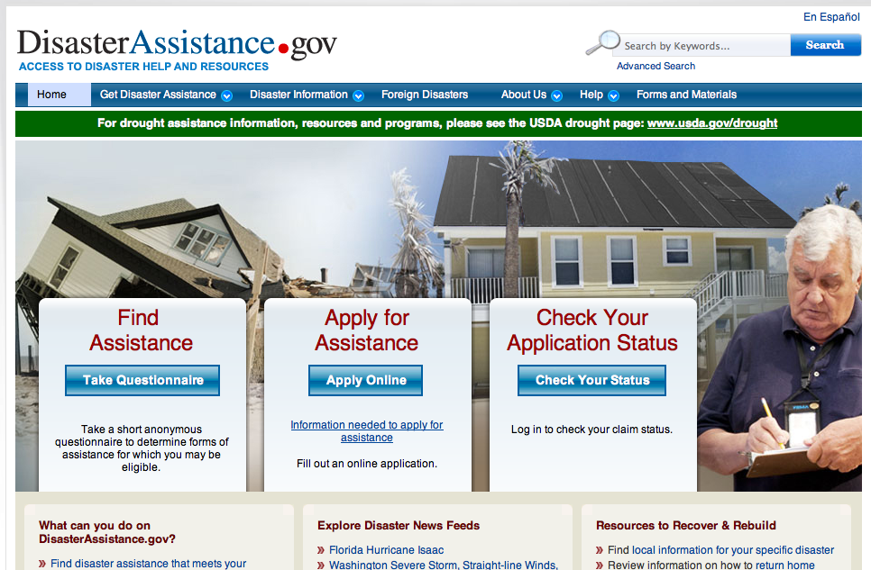
FEMA’s Brands

Slide 7
FEMA.gov

Slide 8
FEMA.gov

Slide 9
FEMA.gov

Slide 10
FEMA.gov

Slide 11
FEMA.gov
Disaster
Assistance
.gov
Ready.gov

Slide 16
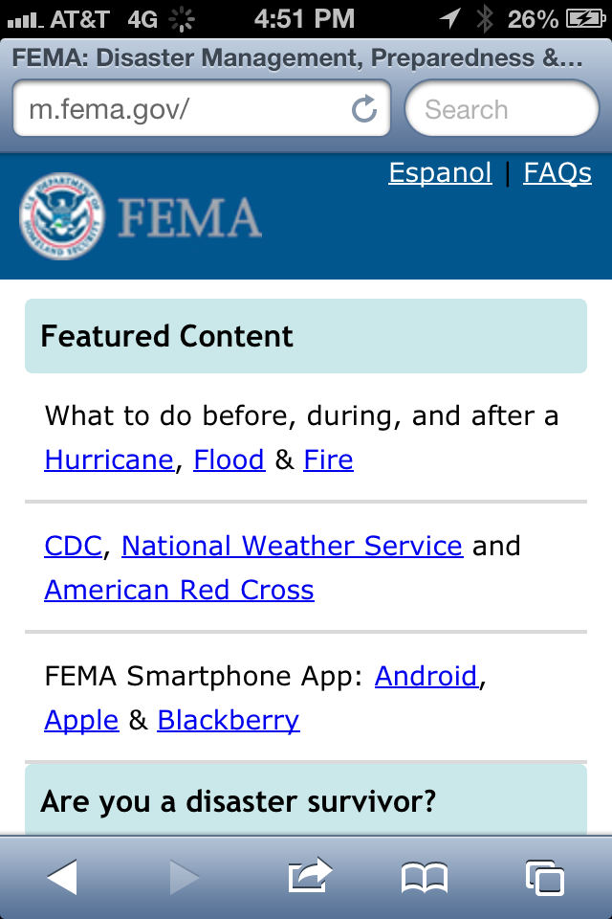
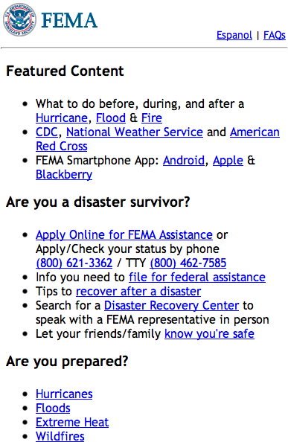
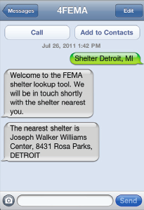
FEMA’s Platforms
Web
Mobile Web
Mobile
Applications
SMS Text Messaging

Slide 17
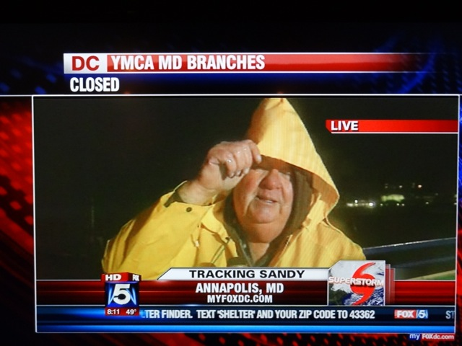

Slide 18
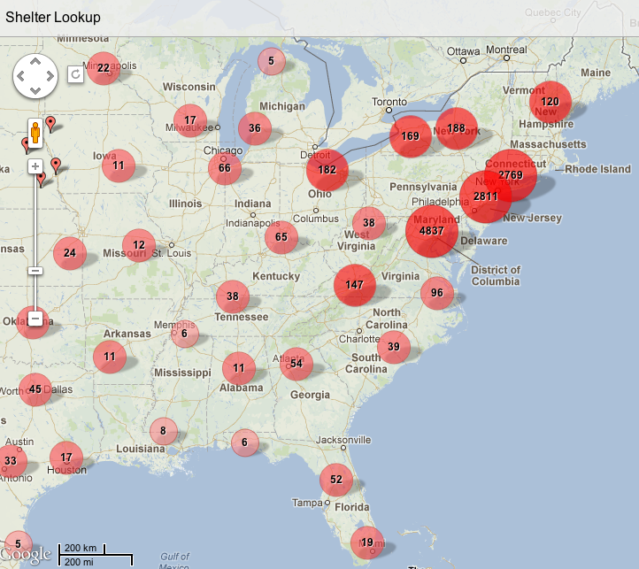
97% of Mobile Phones Support SMS Text Messaging
Search for open shelters by texting SHELTER and a Zip Code to 43362 (4FEMA) Ex. Shelter 01234 (std rates apply)

Slide 19
Text PREPARE to 43362 (4FEMA) to receive monthly preparedness tips. (msg/data rates apply)

Slide 20
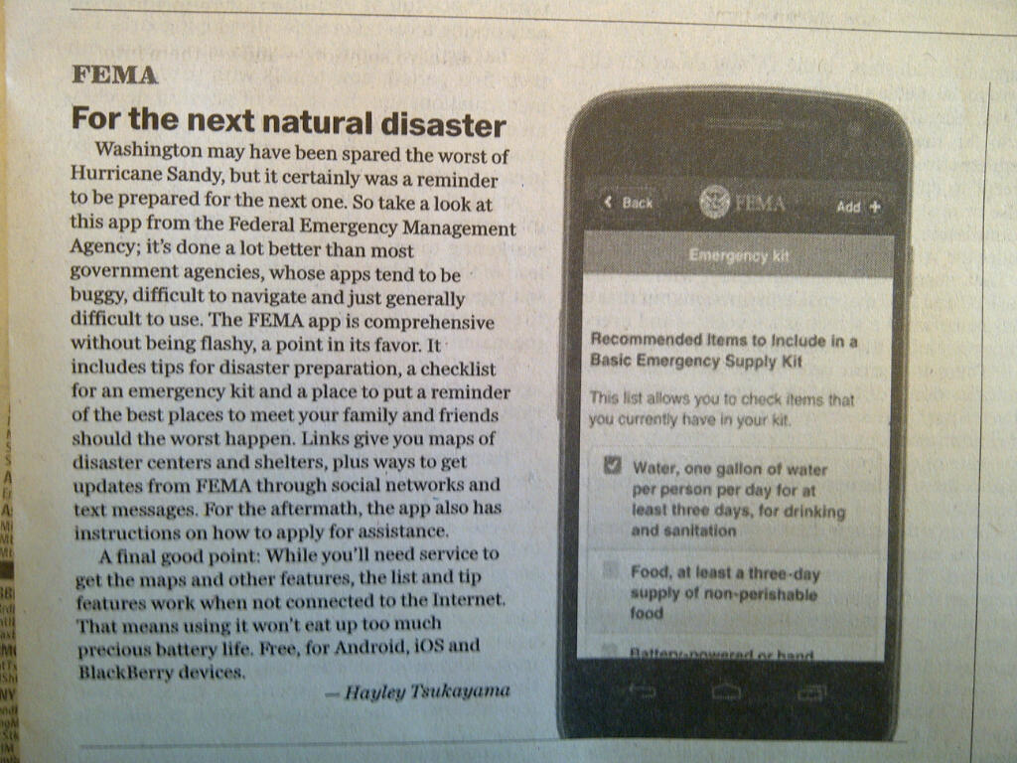
Washington Post, November 3rd, 2012

Slide 21
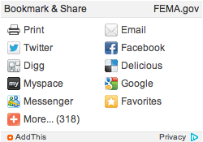
Social Media

Slide 22
Foresee
Used on each of FEMA’s brand websites
Used on m.fema.gov
Launching Session Replay on FEMA.gov

Slide 23
The 12-Month Trend

Slide 24
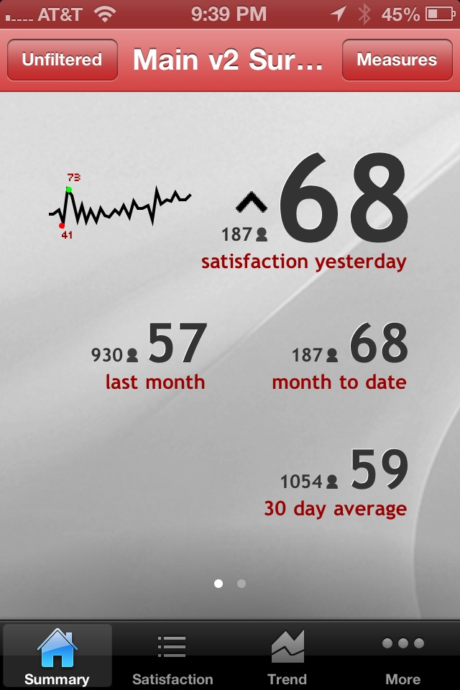
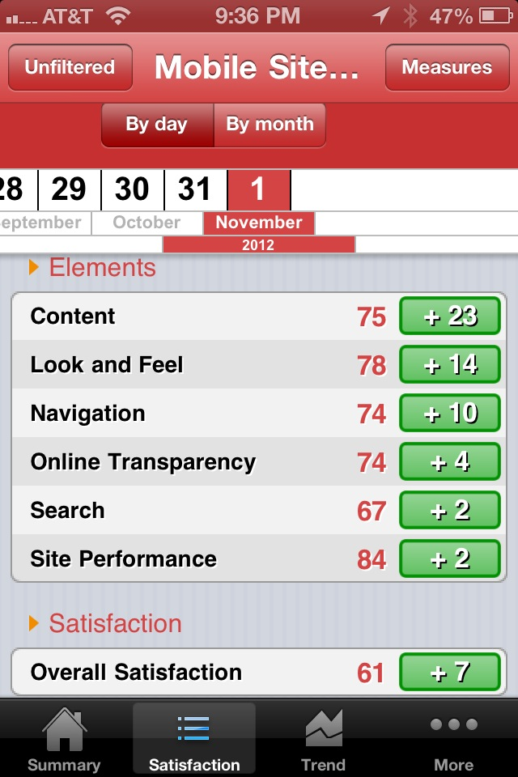
Foresee Mobile Portal App

Slide 25
Text “RECOVERY” to 52000 to donate $10.00 on behalf of United Way of NYC
Text “BOWERY” to 20222 to donate $10.00 on behalf of The Bowery Mission
Text “UWHC” to 52000 to donate $10.00 on Behalf of the United Way of Hudson County, NJ
Text “HOPE” to 501501 to donate $10.00 on behalf of Nazarene Compassionate Ministries
Text “REDCROSS” to 90999 to give $10 to American Red Cross Disaster Relief

Slide 26
Thank you
Any questions please contact Ms. Tina Adinolfi
Bettina.Adinolfi@fema.gov

