Slide 1
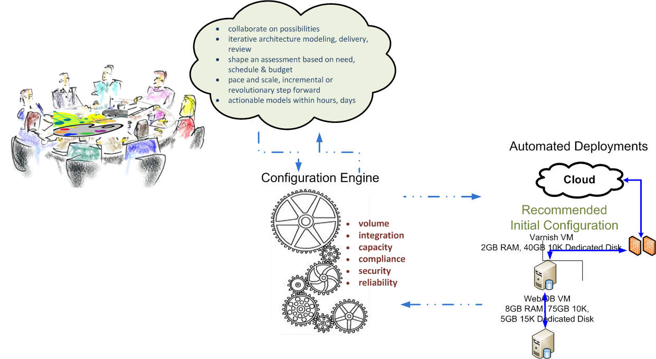
Sustainable Cloud Applications
Overview
Capabilities
Starting your Journey
Strategy
Architectures
Building Your Solution
Implementation
Quality, Security, Monitoring
Maintaining
A Great User Experience

