Slide 1
Buenos Aires Implementation Strategy
Daniel Abadie
Electronic Government Director
This is the story of a Drupal implementation strategy and how a government community grows in Buenos Aires, Argentina.

Slide 2
A path to a smart government
BA City Digital Strategy
Old Governments websites are Dead
User-driven web experience
Architecture and Modules
Solving a puzzle
Architecture
Modules
Migration
Digital Platform
Putting a Team Together
Building up a community in Gov

Slide 3
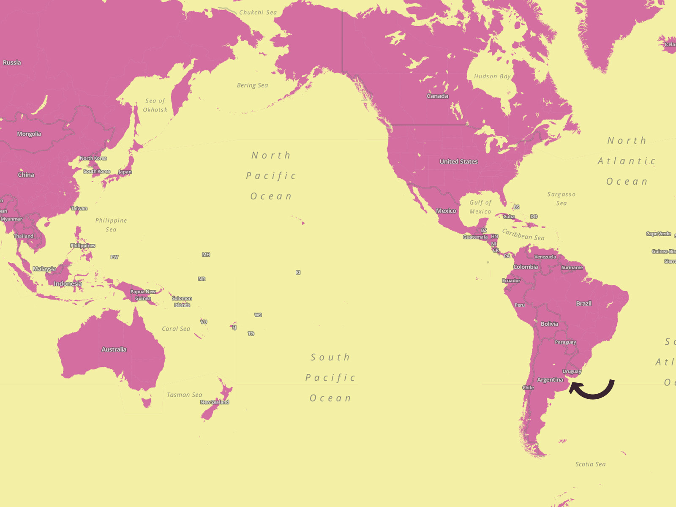
Buenos Aires 101
It’s the Capital and Largest City of Argentina
3 Million people live here
About 4 million people commute to the city from the metropolitan area every day.
BA is a City & a state
BA City Gov has about 180.000 employees
33 Public (and free) Hospitals
1200 Public (and free) schools + 1000 Private Schools
2/3 of City Budget applies to Health, Education and Social Aid.

Slide 4
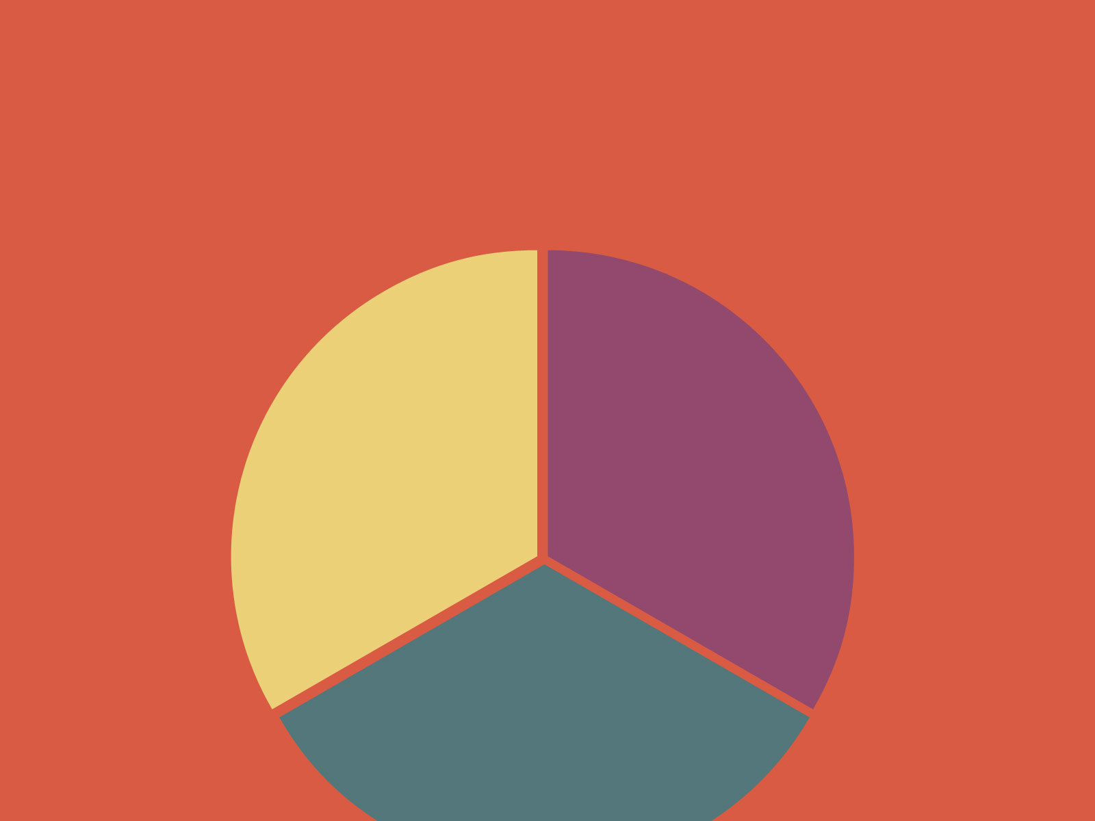
Buenos Aires Digital Strategy
Political Support from the Mayor
3 teams with 1 goal
In House Dev
eGov
office
New Media
office
Open
Gov
office

Slide 5
Old government websites are DEAD
Buenos Aires gov
1st website
1997

Slide 6
Old government websites are DEAD
Buenos Aires gov website
2004-2009

Slide 7
Old government websites are DEAD
400 Websites
Focus on gov structure and egos of the officials on duty
Buenos Aires gov website
2004-2009

Slide 8
User-driven web experience
How do we integrate 400 websites in just 1?
How to organize at least 70 web teams in gov into a single strategy?
How to manage a 190 million page views a year website and keep a 99.9% uptime?
How can we improve the user experience and focus on the citizen?
So... 2 years ago….

Slide 9
User-driven web experience
I want to get married
I need to choose a school for my kid
I have to get an appointment for my driver’s license

Slide 10
Architecture and Modules: Solving a Puzzle
Needs | Solutions
3-Click browsing to reach content | User-Driven content planning
Granularity in Roles and Permissions | Organic Groups Permissions + Field Permission + Core Role System
Decentralized Development and Version Control (SCM) | GIT & Features
Multiple Forms administration | Custom Module & Django API with MongoDB (BA API)
Geotagging | Custom GIS Module
Flexible Search Engine | SolR & Lucene + Custom Module
Standarizing UI and UX Design | Twitter Bootstrap
Web Accelerator and Caching | Varnish & MemCache
Content Workflow | Workflow Module

Slide 11
Architecture
VARNISH
DRUPAL
buenosaires.gob.ar BATourism
MEMCACHE / MYSQL
SOLR
API GCBA
MONGO
GIS
BA ID
openID/Oauth
OpenX Ads

Slide 12
Modules
Panels
Forms (BA API)
GIS
Organic Groups
BA OpenX
Views
Social Block
Workflow
SolR

Slide 13
Modules we
Panels
Multiple layouts
UI Friendly
Views
Fast
Easy to print information
Workflow
Organic Groups
Profile & role management
Publishing permissions
Can manage a government structure
Multiple content relationship

Slide 14
Digital platform: Users strike back!
Users
BA Website

Slide 15
Migration
75 000 files + hardcoded HTML + no DB

Slide 16
Migration
Rewrite ALL!
75 000 files + hardcoded HTML + no DB

Slide 17
Migration: Things we take for granted

Slide 18
Buenos Aires Digital Platform

Slide 19
Buenos Aires Digital Platform

Slide 20
Buenos Aires Digital Platform

Slide 22
BA Tourism site

Slide 23
BA jobs postings site

Slide 24
Putting a team together
PHP Devs
UX Design
Web Design
Python Devs
PMO
New Tech
Content
GIS Unit

Slide 25
Putting a team together

Slide 26
Building up a community in Gov
Government innovation…
…is not about the apps!

Slide 27
Building up a community in Gov
It’s about changing the culture!

Slide 28
Building up a community in Gov
Drupal Module Dev training for Gov employees
Adopting Git and Github
Learning how to code for Drupal
Contractor’s Drupalization
Don’t develop a New Website. Instead build us a module or a theme.

Slide 29
Building up a community in Gov
BA GovCamp ’12

Slide 30
Building up a community in Gov
BA GovCamp ’12

Slide 31
Please, ask me anything

Slide 32
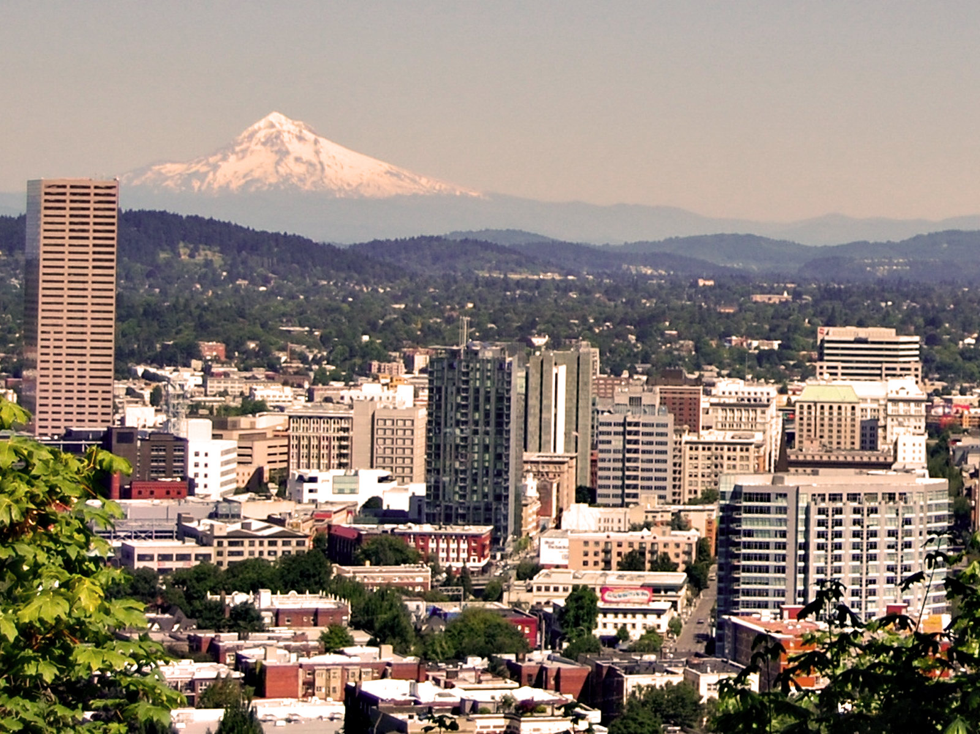
Thank you!
@dan_abadie
www.buenosaires.gob.ar
github.com/gcba
twitter.com/gcba

Slide 33
What did you think?
Evaluate this session at: portland2013.drupal.org/schedule.
Thank you!
Building Bridges, Connecting Communities

